Slide 1
House Price EDA and Prediction

Slide 2
Introduction
House Prices Differ upon many variables , maybe it’s possible to guess the range of the prices
Without asking by yourself in a particular town or area. we will dive through House prices Dataset and get some insights that can be useful through our analysis .
Our Main steps:
Explanatory data analysis (EDA)
Feature Selection and Preprocessing
Modelling

Slide 3
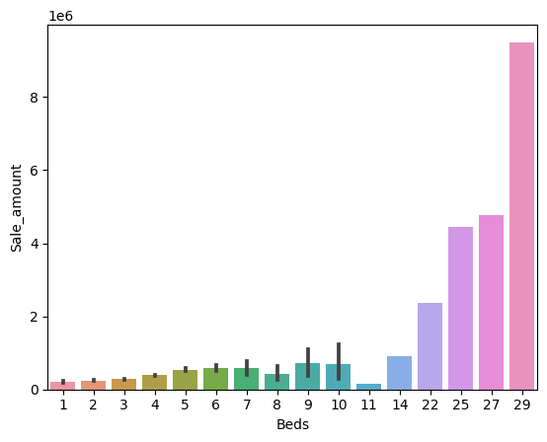
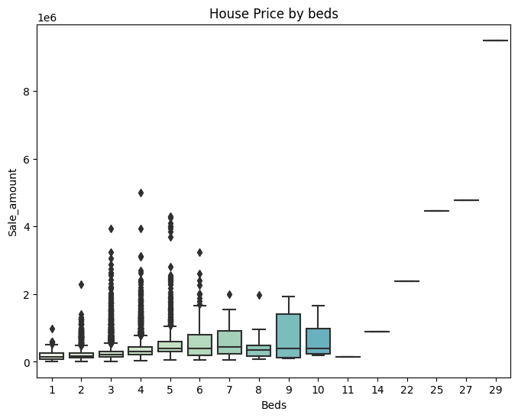
Explanatory Analysis
House Price against Number of Beds Box Plot and Bar plot

Slide 4
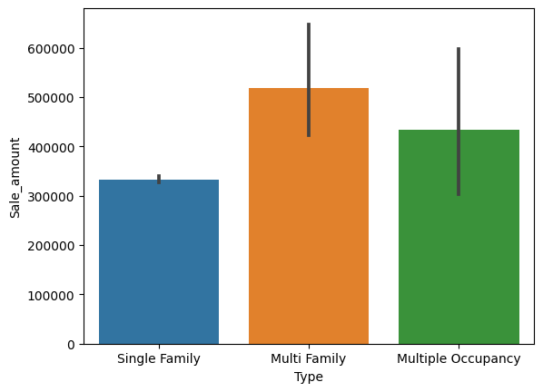
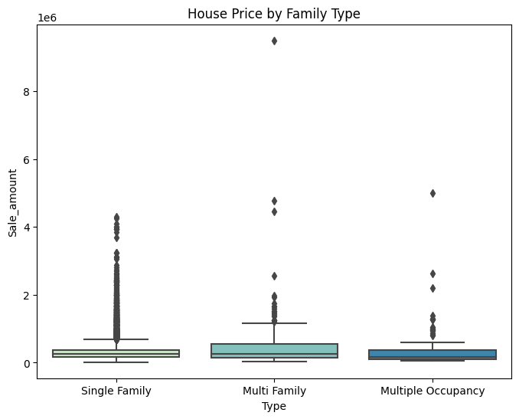
Explanatory Analysis
House Price against Types of families

Slide 5
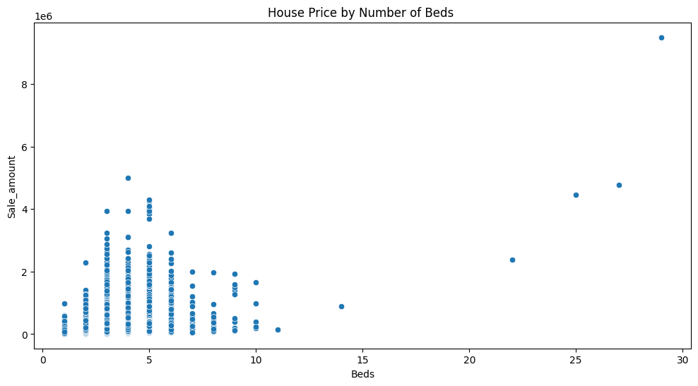
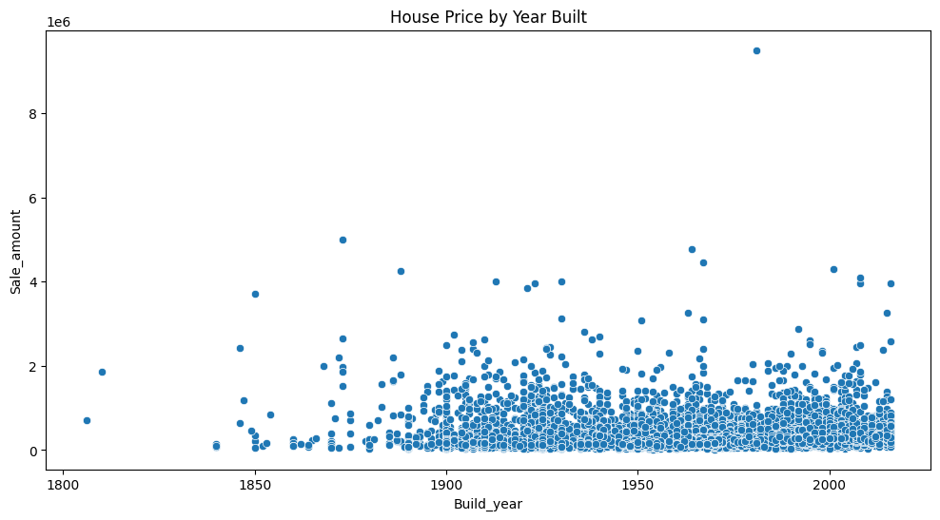
Explanatory Analysis
Scatter Plot of house Price against Number of beds
Scatter Plot of house Price against Year built

Slide 6
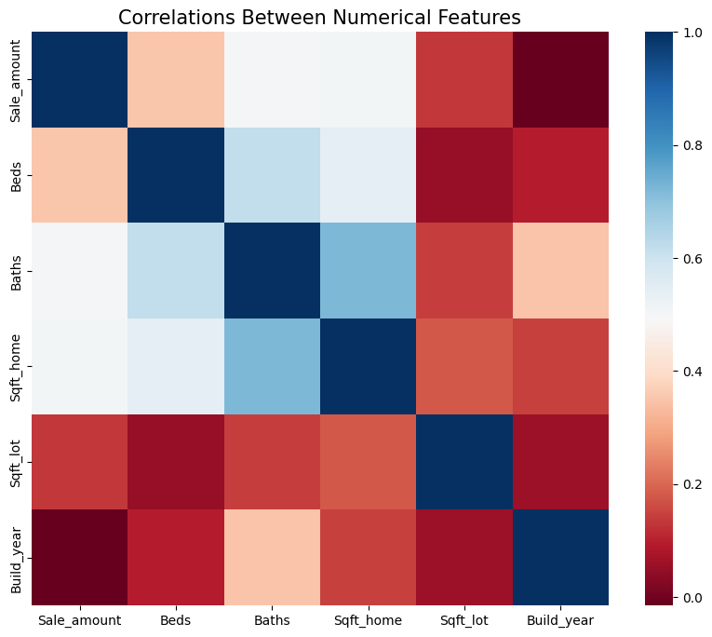
Explanatory Analysis
Correlation between all the numerical features

Slide 7

Research Questions
1-Is there a significant difference in the House Sale Price for types of the families category?
Is there a significant difference in the House Sale Price for number of bedrooms category?
Can we Predict the House Sale Price using Our features of each record of houses ?

Slide 8
Data Preprocessing
-Encoding the categorical Variable using One Hot Encoding in order to feed the data to our model.
Normalization for the numerical Data

Slide 9
Model
We used Linear regression model as it’s simple and good choice for continuous numerical targets.
Result:
MAE | MSE | RMSE | R2_score
93450.484 | 7423671.63 | 272464 | 0.47

Slide 10
Thank YOU !

